Slide 1
Dawn of The Sticks
Nick Adrian
Chris Overcash
Zach McKnight
Thao Le

Slide 2
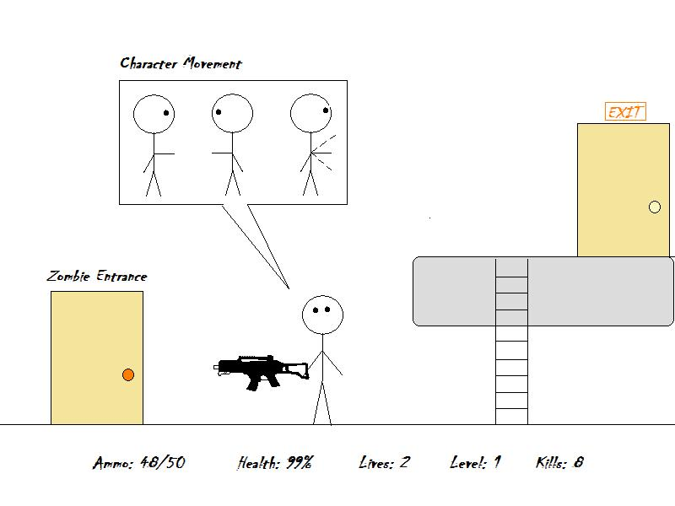
Graphic

Slide 3
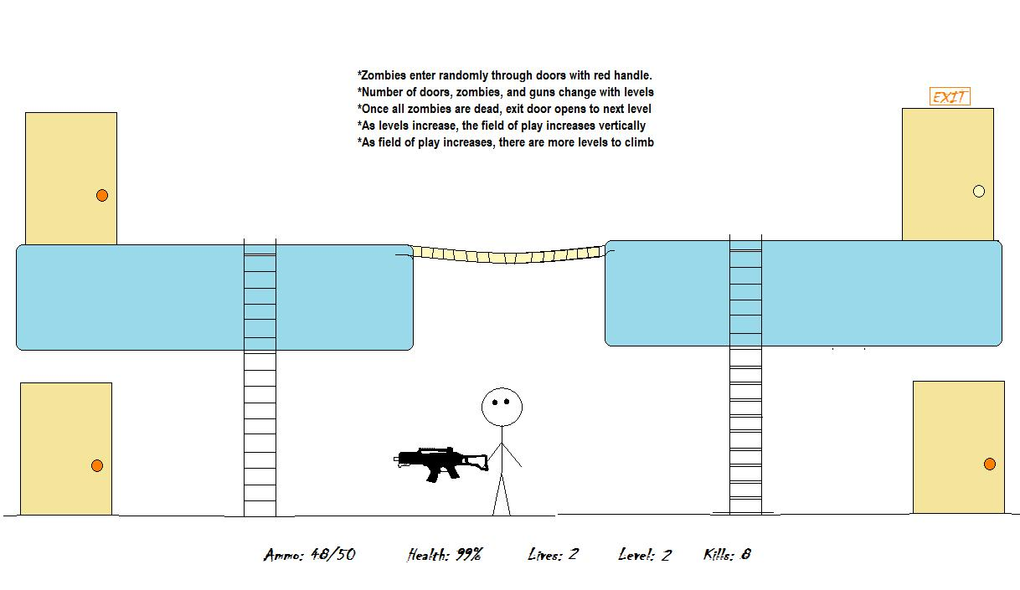

Slide 4
Use Cases For the First Release
Be able to move the character around(Left, Right, and Up)

Slide 5
Tasks for First Release
1. Title Screen
2. Horizontal Movement of Character
3. Basic Map levels

Slide 6
Who Does What Task
Nick Adrian(Title Screen)
Chris Overcash(Character Movement)
Zach McKnight(Game Maps)

Slide 7
Time To Complete each Task
February 7th
February 7th
February 7th

Slide 8
Platform
Desktop Application

Slide 9
API/Toolkits
Unity/JGAME

Slide 10
Log of Meetings
1/27/12: Nick, Zach, Chris
1/30/12: Nick, Zach, Chris

